Slide 1
Team 4 ESE 2017
Simon Sidler, Fabian Loosli, Michael Rötheli, Robin Steiner

Slide 2

Themes
Team Communication
Project Development
Project Features
Demo
Bugs

Slide 3
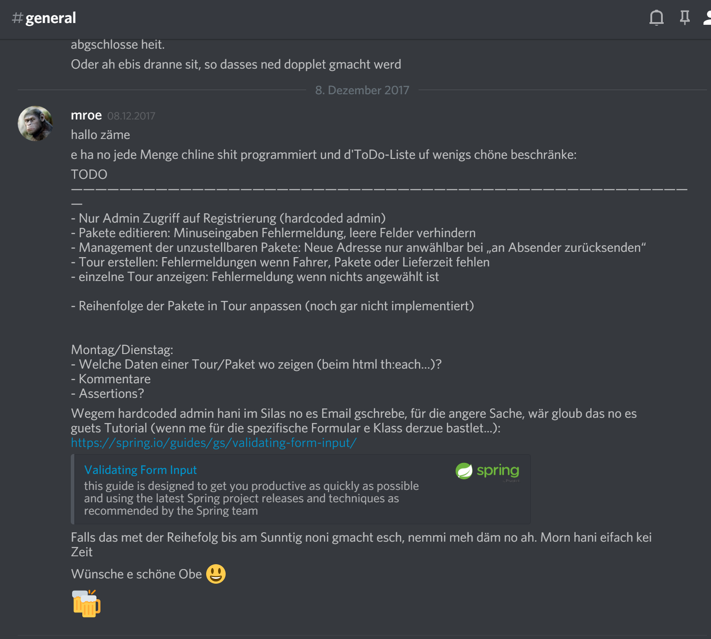
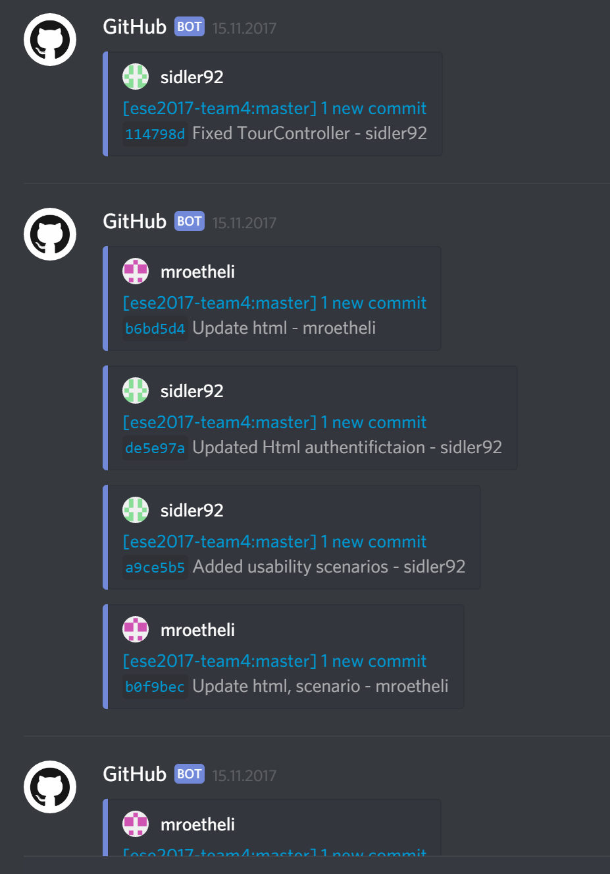


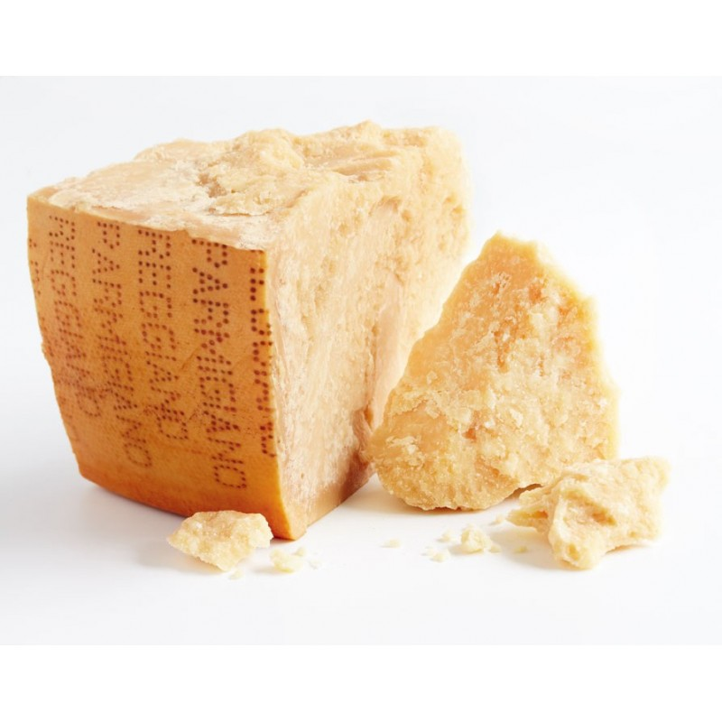
Team Communication
Discord, Whatsapp (secondary)
Github Discord Channel
Weekly Team Meetings

Slide 4
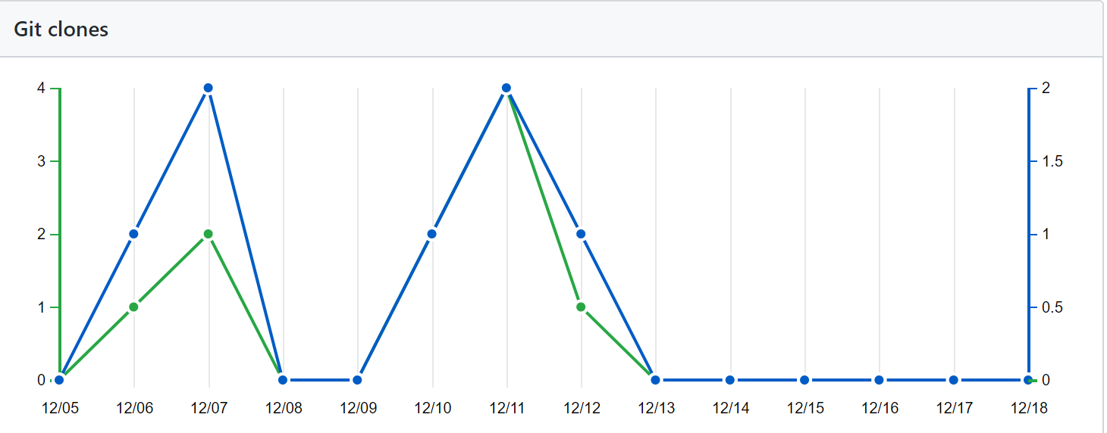
Project Development
Get used to Spring
Assign tasks (Todo List)
Github and merging

Slide 5
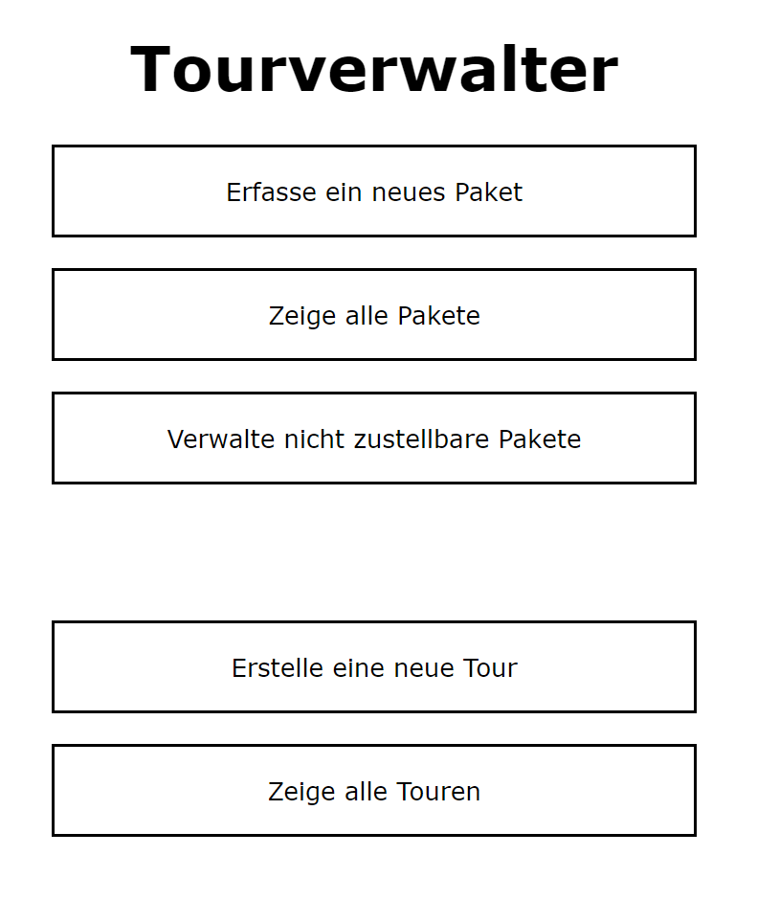
Project Features
German
Create tours and allow drivers to access them
Package history
Package editing
Not delivered packages
Simple interface

Slide 6


Slide 7
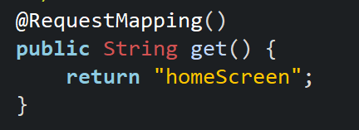
Bugs
Linking of stylesheet
Chrome animation bug

Slide 8


